Slide 1
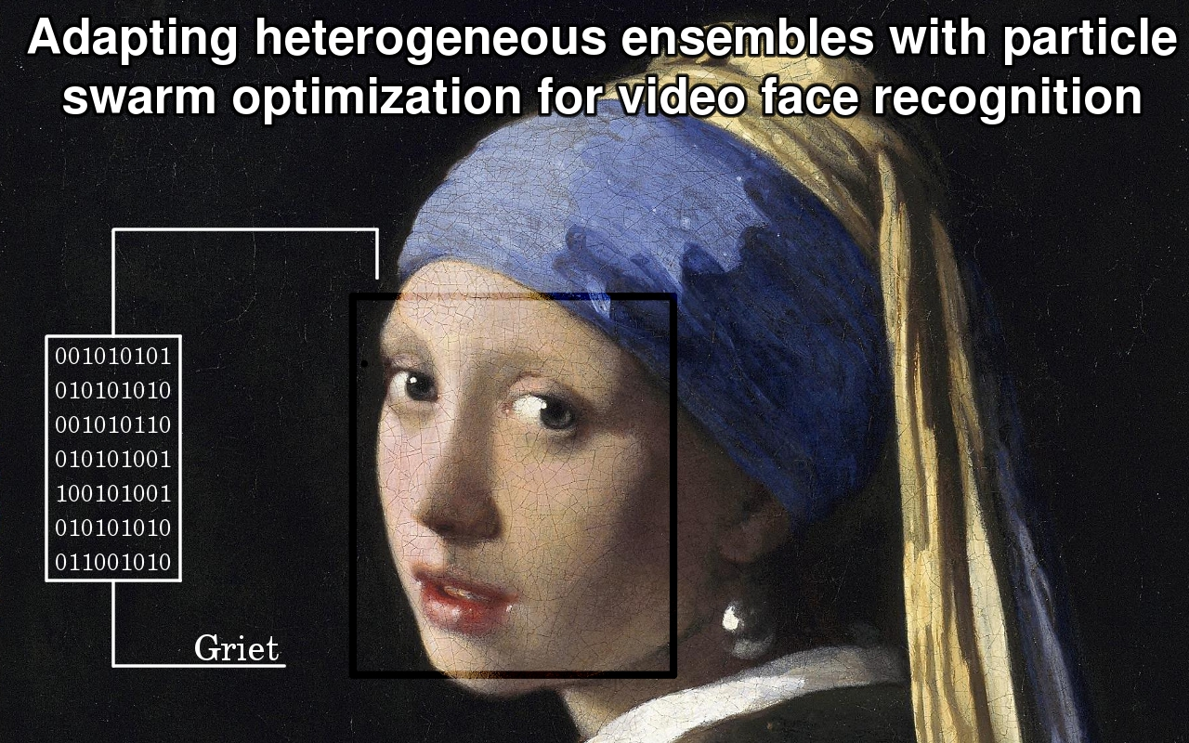

Slide 2


Jean-François Connolly
Adapting heterogeneous ensembles with particle swarm optimization for video face recognition
Under the direction of
Prof. Éric Granger, Ph. D.
Prof. Robert Sabourin, Ph. D.
____ École de technologie supérieure
__________ Laboratoire d’imagerie, de vision et d’intelligence artificielle

Slide 3
Video face recognition system

Slide 4
Challenges of video face recognition
Data acquisition involving humans
Small quantity of data
For surveillance applications,
data is acquired discreetly in an unconstrained scene
(low resolution, noise, and variations in time)
Complex data structure

Slide 5
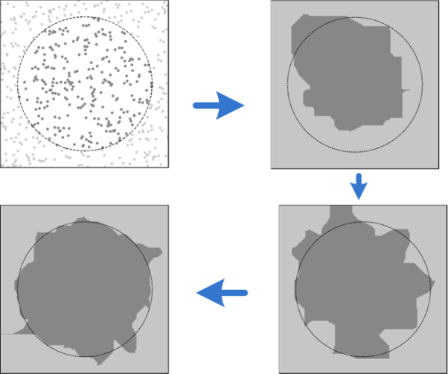
Objective
Provide the means to update class models through incremental learning of new data:
Learning information from new data
Access to previously acquired learning data
Preserve previously acquired knowledge
Accommodate new classes
Adapt a classifier’s plasticity
Update models according to
Accuracy
Computational cost (predictions in real time)

Slide 6
Incremental learning scenarios

Slide 7
Adaptive multiclassifier system*
*From: Dynamic multi-objective evolution of classifier ensembles applied to video-based face recognition (2012).
A Long Term Memory that captures data from each class.
Swarm of incremental classifiers guided by a dynamic particle swarm optimization algorithm
An archive that selects non-dominated classifiers
An ensemble selection and fusion module

Slide 8
Outline
2
3
4
1
Incremental classifier and general idea of the system
Relationship between the swarm of classifiers and the optimization module (chapters 1 & 2)
Long term memory (briefly)
Aggregated dynamical niching particle swarm optimization for ensembles (chapter 3)
Archive and selection (chapter 3)

Slide 9
Incremental learning with Fuzzy ARTMAP: adapt hyperparameter vector h = (α,β,ε,ρ).

Slide 10
Heterogeneous ensemble generation and selection

Slide 11
Study relationship between ...

Slide 12
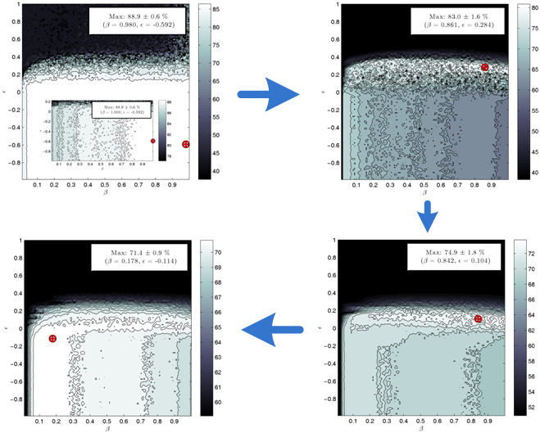
1. Adaptation = dynamic optimization problem

Slide 13
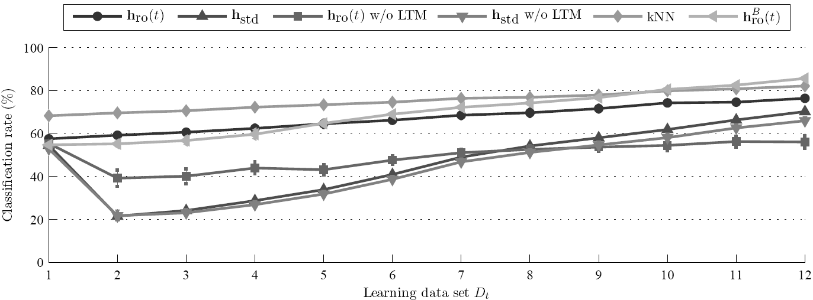
2. Long term memory: store data from all classes during incremental learning.
Otherwise, optimization at a time t is performed only according to the current class.

Slide 14
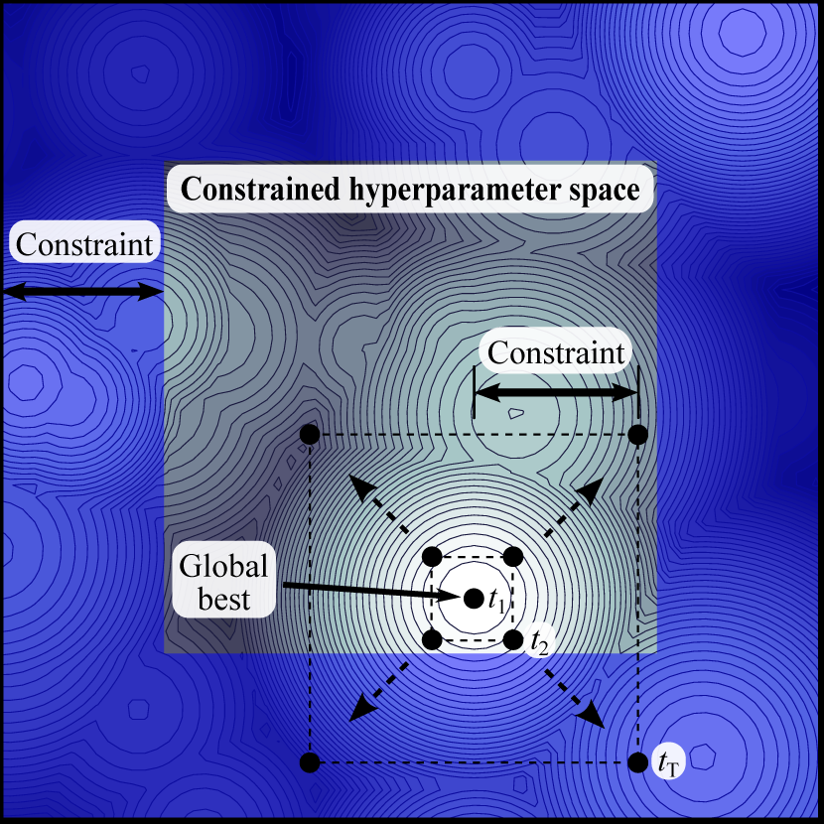
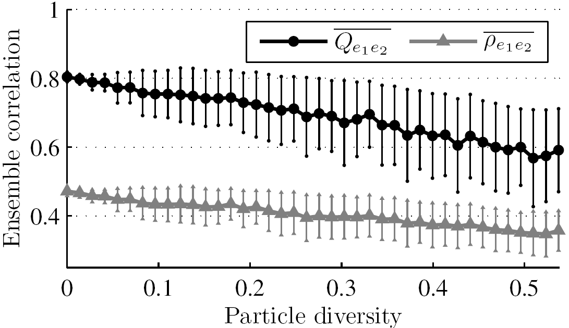
3. Diversity in the optimization environment ∝ diversity in the classification environment.
Experiment
Result

Slide 15
Optimization problem
What we know
Dynamic optimization problem (Chapter 1)
Diversity in the optimization environment ∝
diversity in the classification environment. (Chapter 2)
What we need
Minimize error rate
Minimize fuzzy ARTMAP network size (computational cost).

Slide 16
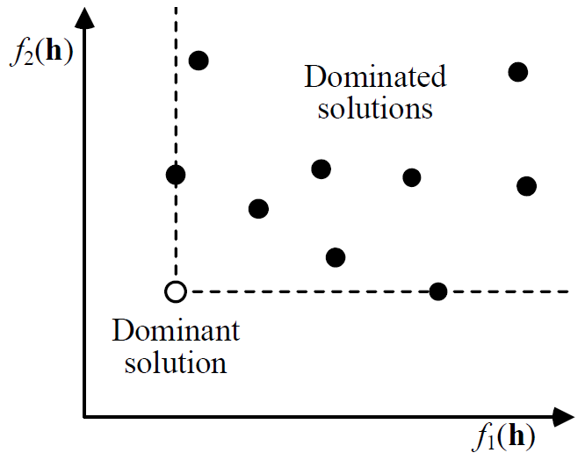
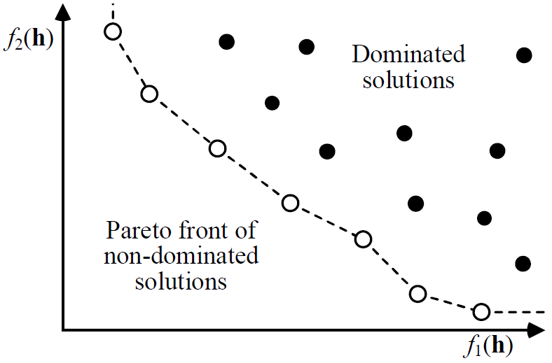
Multi-objective optimization problem
Go there!

Slide 17
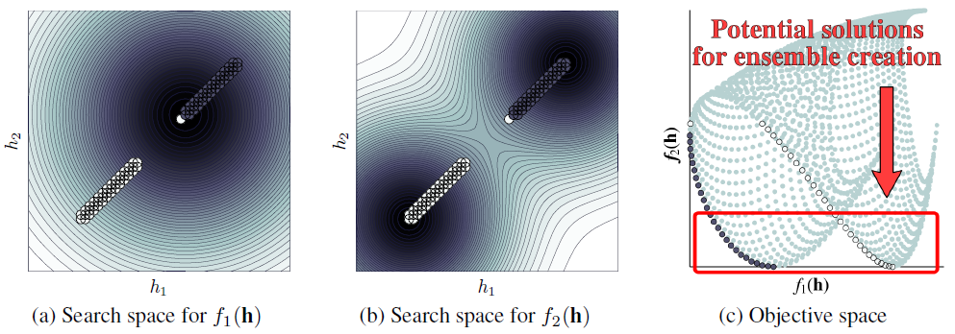
Specification for ensembles
Detect local Pareto front
Detect local optima
Detect solutions between the local optima

Slide 18
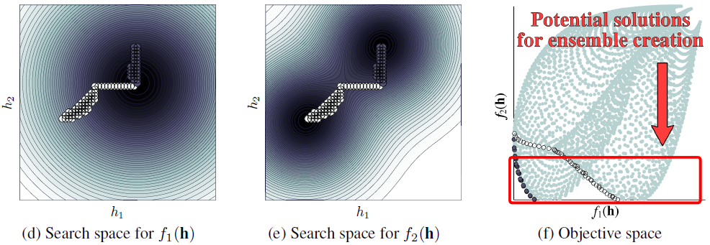
Specification for ensembles
… and follow everything in a dynamic optimization environment

Slide 19
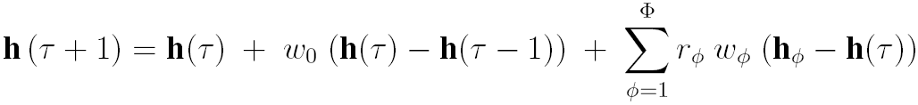
Particle swarm optimization
Equation
Illustration
Final position
Inertia
Initial position
A sum of influences

Slide 20
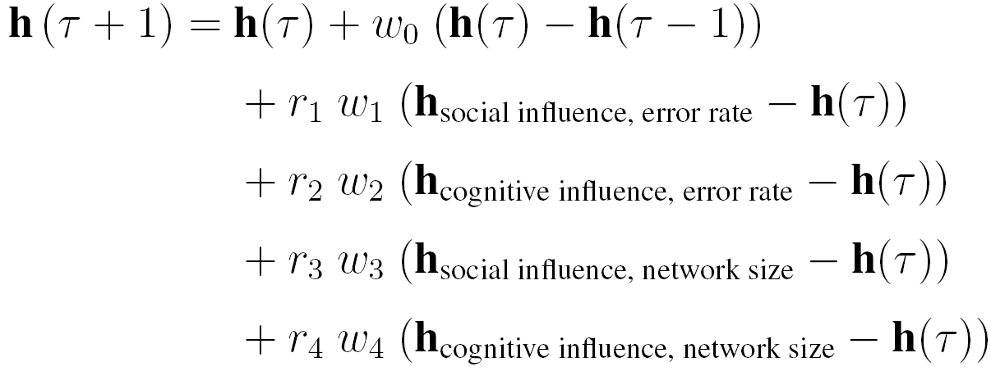
Aggregated dynamical niching particle swarm optimization
Cognitive influence: personal best position
Social influence: local best position

Slide 21
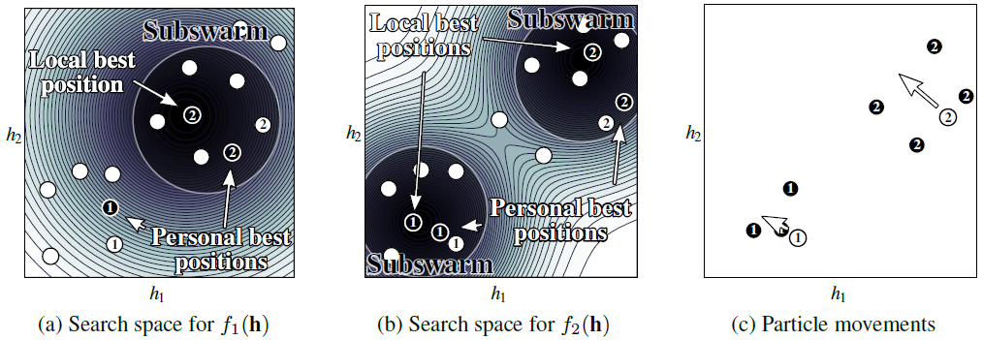
With subswarms defined dynamically!
Particles
Influences

Slide 22
Specialized archive and ensemble selection
2. Additional selection to maximize diversity with a greedy search algorithm (Chapter 2)

Slide 23
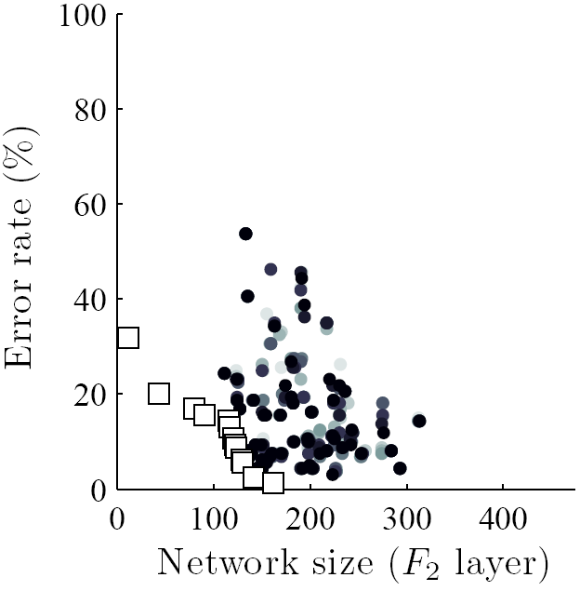
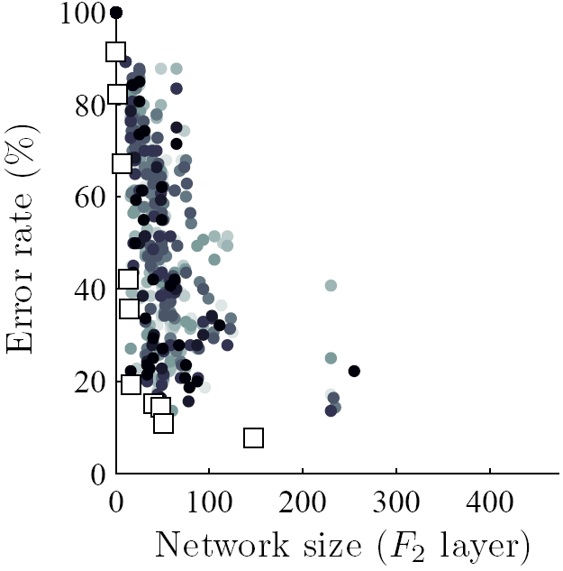
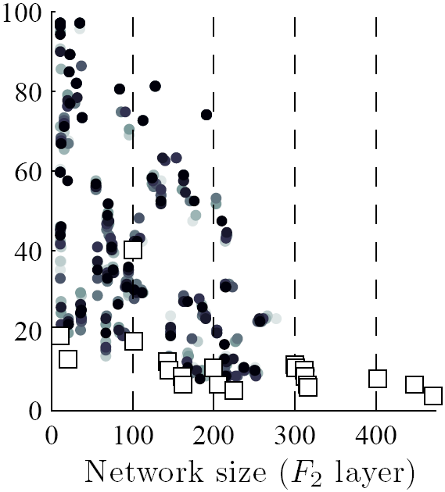
Result in the objective space
Mono-objective optimization
(accuracy)
Classique
Multi-objective optimization
ADNPSO

Slide 24
Impact of incremental learning on accuracy
Video face recognition: several face images are used to performed recognition

Slide 25
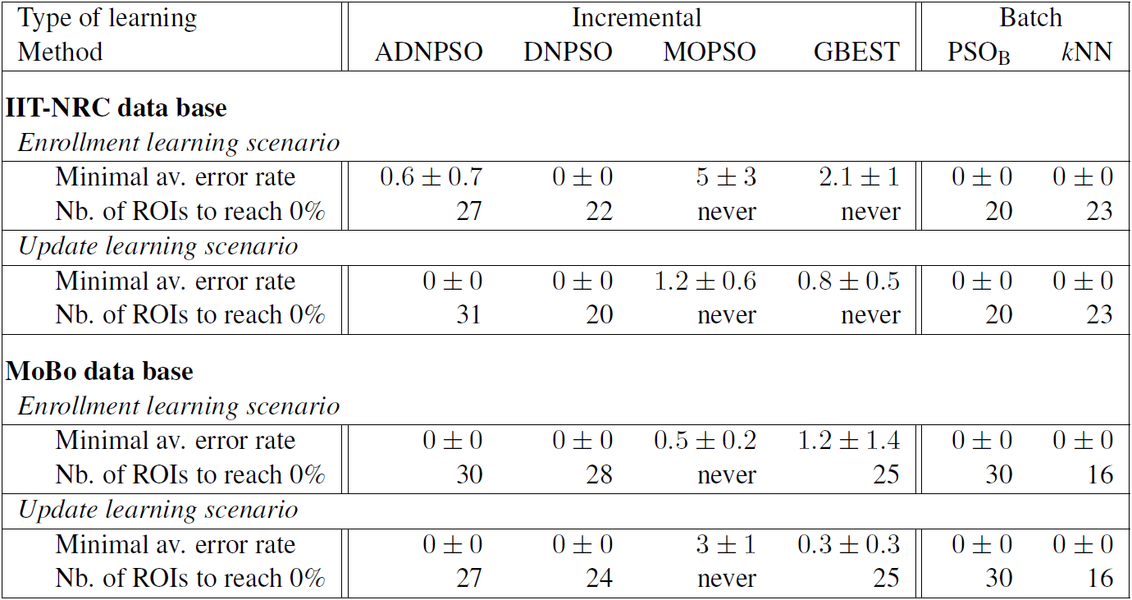
Accuracy: number of regions of interest to reach an error rate comparable to 0%

Slide 26
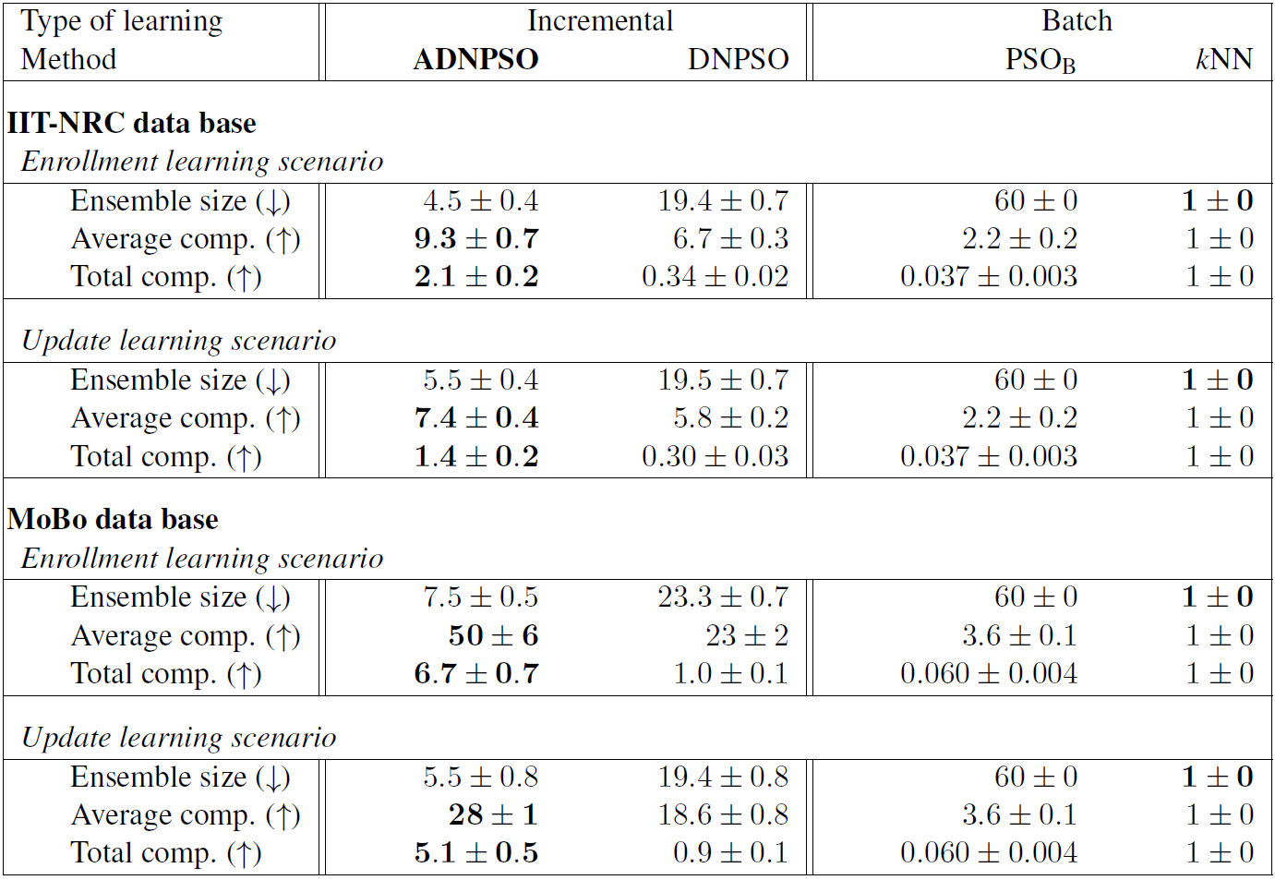
Computational complexity: network size

Slide 27
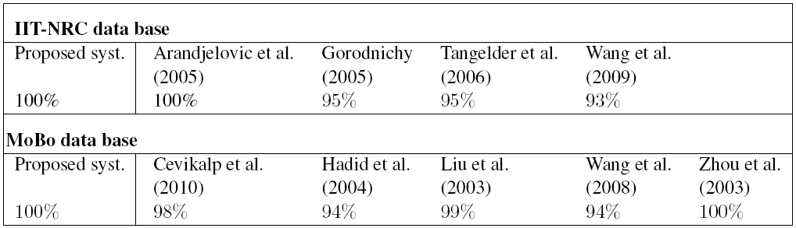
Compared to other systems (that performed batch learning)

Slide 28
Conclusion – main contributions
Proposed
Adaptive multiclassifier system
Aggregated dynamical niching PSO algorithm
Greedy search algorithm for diversified ensemble selection
Incremental learning strategy
Redefined properties needed to performed incremental learning
Characterized the relationship between the two environments
Dynamic optimization problem
Diversity –vs– diversity

Slide 29
Conclusion – main contributions
3 journal articles
Jean-François Connolly, Eric Granger, and Robert Sabourin. 2012a. “ An adaptive classification system for video-based face recognition ”. Information Sciences, vol. 192, n. 1, p. 50–70.
Jean-François Connolly, Eric Granger, and Robert Sabourin. 2012b. “ Evolution of heterogeneous ensembles through dynamic particle swarm optimization for video-based face recognition ”. Pattern Recognition, vol. 45, n. 7, p. 2460–2477.
Jean-François Connolly, Eric Granger, and Robert Sabourin. 2012 (submitted, reference no.: ASOC-D-12-00025). “ Dynamic multi-objective evolution of classifier ensembles applied to video-based face recognition ”. Applied Soft Computing.
7 communications
ANNPR, CEC, CIBIM, CISDA, ICPR, IJCNN

Slide 30
Conclusion – future work
Classification environment
Characterize learning samples with
face images quality measures
Other statistical measures
Use these measures to
Define a pattern presentation order when learning data
Redefine how the long term memory is used
Prove that we have concept drift
Optimization environment
Compute local diversity instead of global diversity
Find the diversity measure most correlated with classifier diversity
Both environments
Use change detection measures

